Slide 1
Overview
Show some SAS output?

Slide 2
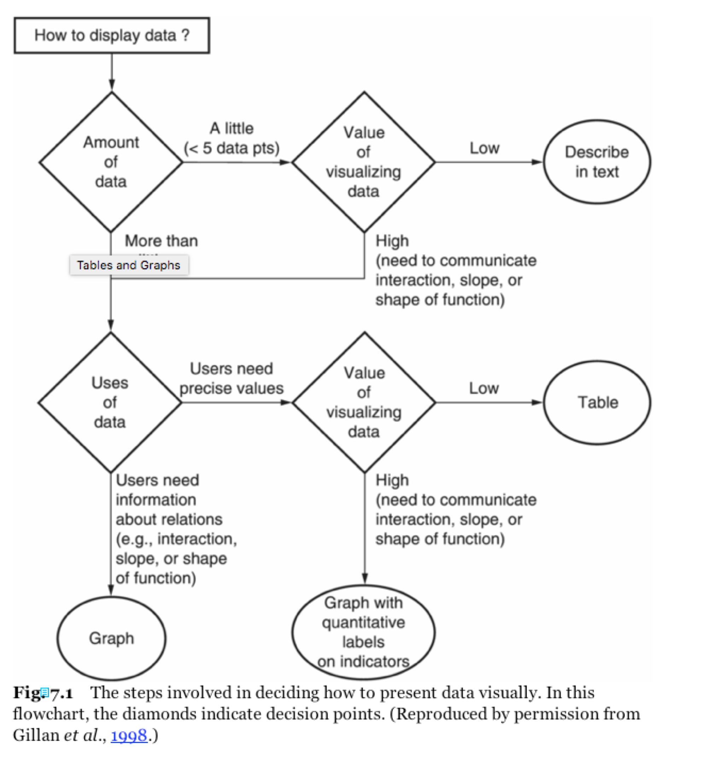
Notes:
flowchart

